Slide 1
Lesson objective
Title: Averages
Aim – be able to:
Calculate mean, mode and median from different forms of represented data.

Slide 2
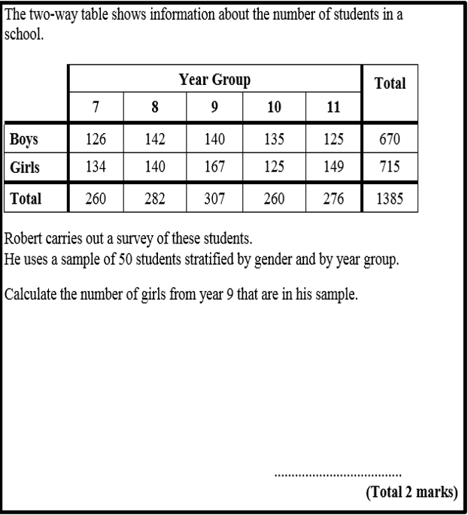
Divide members by total population
Multiply to sample amount (total number in survey)

Slide 3
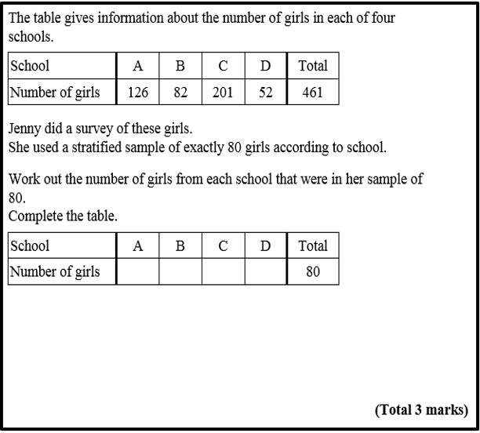
Divide members by total population
Multiply to sample amount (total number in survey)

Slide 4
Selection bias, where the results are skewed a certain way because you’ve only captured feedback from a certain segment of your audience.
E.G :
Only asked old people or gender specific
Chosen a time or day that would NOT be inclusive
Response bias, where there’s something about how the actual survey questionnaire is constructed that encourages a certain type of answer, leading to measurement error.
E.g.
Leading question
Choices for response are poorly displayed or arranged

Slide 5
What is wrong with this question?
No Time Frame
Overlapping Options
How many times do you go to the gym?
1 – 5
5 – 10
10 – 15
15 – 20
What if you don’t use the gym?
What if you use the gym more than 20 times?
Notes:
There are at least 4 things wrong with this question. Give students a minute to discuss the question with their neighbour to see if they can identify the mistakes.

Slide 6
What is wrong with this question?
Emotive Language
Given than smoking kills millions of people each year, don’t you agree that it should be banned?
Leading Question
Yes
No
No option for those without an opinion/undecided
Notes:
There are at least 3 things wrong with this question. Give students a minute to discuss the question with their neighbour to see if they can identify the mistakes.

Slide 7
What is wrong with this question?
No Time Frame
Ambiguous options
How often do you walk your dog?
Quite A lot
Never
A lot
Regularly
All the time
Overlapping options?
What if you don’t own a dog?
Notes:
There are at least 4 things wrong with this question. Give students a minute to discuss the question with their neighbour to see if they can identify the mistakes.

Slide 8
I do example
11, 15, 17, 19, 22, 24, 29, 31, 35, 40, 41, 41, 45 r
Mean:
Mode:
Median

Slide 9
Whiteboards ready

Slide 10
Find the mean of these numbers
36, 2, 4, 48, 6,12, 20,16

Slide 11
The mean is
18

Slide 12
Find the mode of these numbers
2, 4, 5, 3, 3, 7, 6, 8, 9, 4,1, 3

Slide 13
The mode is
3

Slide 14
What is the median of these numbers?
14, 6, 2, 12, 8, 6, 2
HINT: rearrange, lowest to highest then find median.

Slide 15
The median is
6

Slide 16
Find the mean of these numbers
36, 2, 2, 48, 8, 12, 20, 16

Slide 17
The mean is
18

Slide 18
Find the mode of these numbers
7, 5, 3, 2, 5, 6, 8, 7, 5

Slide 19
The mode is
5

Slide 20
Find the median of these numbers
6, 4, 8, 14, 8, 6, 38

Slide 21
The median is
12

Slide 22
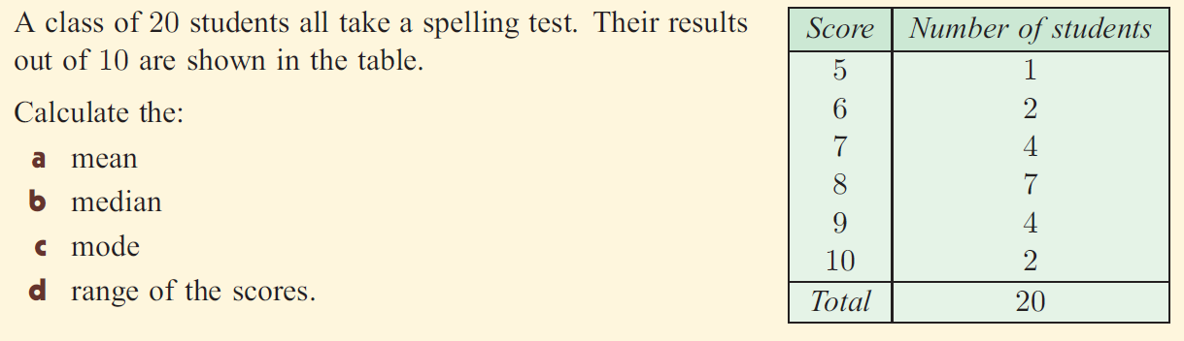
LO: TBAT calculate the averages from a frequency table.

Slide 23
Averages
0 0 0 0 0 1 2 3 2 2 3 0 0 0 1 1 2 1 1 1 0 1 0 0 0 0 3 3 2 0 0 0 1 1 1 1 1 0 0 2 1 0 2 1 1 0 0 0 0 0
We can put this information into a frequency table to make the calculation easier
Number of pets | Tally | Frequency
0
1
2
3

Slide 24
Averages
Year 9 did a French test and their results are below. Calculate the mean, mode and range of the data.
Mark (out of 10) | Frequency | M x F
5 | 12
6 | 23
7 | 35
8 | 19
9 | 14
10 | 7
Total

Slide 25
Stem and Leaf Diagrams
Here are the marks gained by 30 students in an examination:
63 58 61 52 59 65 69 75 70 54 57 63 76 81 64
68 59 40 65 74 80 44 47 53 70 81 68 49 57 61
0 4 7 9
2 3 4 7 7 8 9 9
1 1 3 3 4 5 5 8 8 9
Add a KEY:
0 0 4 5 6
5|2 = 52
0 1 1
4
5
6
7
8

